Slide 2
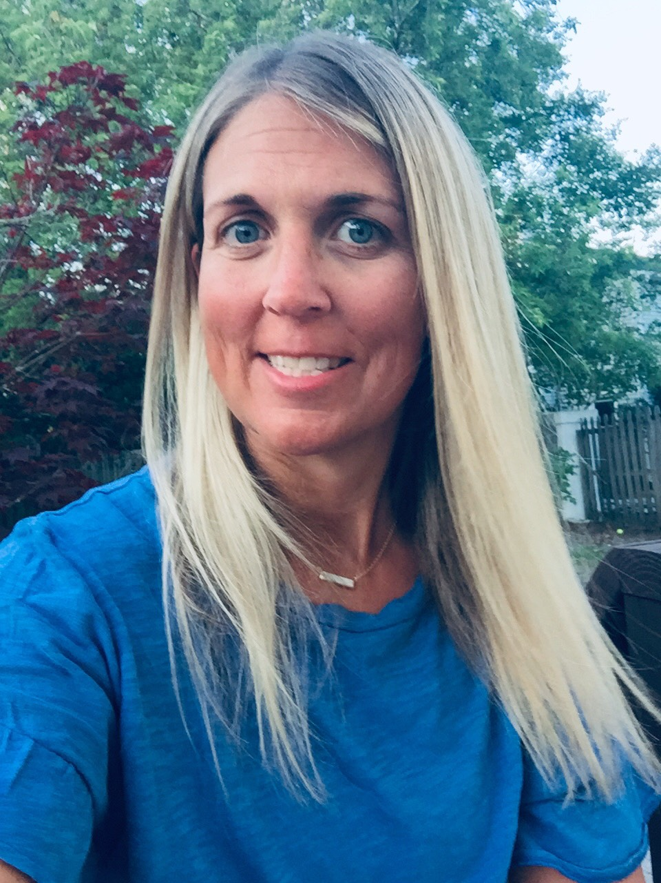
Hello everyone! My name is Kristen Stott and I will be your teacher this year! This will be my 18th year teaching at Bolivia Elementary School and I have taught Kindergarten and First Grade. I am looking forward to a great year of learning together!
Insert picture or bitmoji here!

Slide 3
Color:
Any shade of blue
Stores:
Target
Old Navy
Loft
Belk
Candy:
M&M’s
Dark Chocolate
Lollipops
Snacks:
Pretzels
Strawberries
Drinks:
Diet Dr. Pepper
Water
Sweet Tea

Slide 4
*I live in Wilmington with my husband who is a golf pro and two children. My daughter is a 16 going into the 11th grade and my son is 14 going into the 9th grade.
*I love baseball and watching my son play on his travel, school and legion ball teams.
*I love to be outside and will use any chance I can to be out there!
*I love the beach, looking for shells, and reading a good book while I am relaxing in the sand.
*I have an eight year old golden retriever named Harper who is my world!
*Family is everything to me so once you and your child enter my classroom door, consider yourself family!

Slide 6
We will have snack time in the afternoons! To make it easy, each student can bring in his/her own snack to have. You may send in one snack a day, enough for the week, or longer if you wish. The snacks will be kept in his/her cubby. To help out with spills, we are asking to only send in water at this time. Your child may have a water bottle for class and will be able to have it any time during the day! Thank you for your help with
this!

Slide 7
During the week, we will have different Enhancements. These include Music, Library, PE, and Art. I will have the daily schedule of where we go each day on our weekly newsletter.

Slide 8
*Glue sticks
*Crayons
*Pencils
*Scissors
*Pink Pearl Erasers

Slide 9
Your child will bring home a homework folder every night. A weekly newsletter will be in it telling you our objectives for the week and what the homework will be each night. Homework may not be given every night but if it is, it is usually a quick review of what we are
doing in class and will include phonics,
math, and reading.

Slide 10
As mentioned, we will be using the following platforms online:
*Class Dojo for communication
*Clever app to get your student into I-Ready Reading and Math, Learning A-Z, Letterland and other programs we will be using throughout
the year.

Slide 11
The best two ways to get in touch with me will be through my email: kstott@bcswan.net or send me a message through Class Dojo. If you need to call the school, the number is (910)253-6516.

