Slide 1
2024 WBHS JROTC MILITARY BALL
(SAT, 09 March 2023))

Slide 2
AGENDA
5Ws
Expectations/ Etiquette
APPEARANCE (UNIFORM)
CONDUCT INSIDE & OUT
EATING
DANCING
3. CONCLUSION/COST

Slide 3
5 W’s
Who - All JROTC Cadets, and their pre-approved non- Trojan dates, along with notable members of the community.
What - Males must wear Class A uniform with white dress shirt, (no collar buttons), and bow ties. Females can wear formal dresses, if appropriate.
When- Saturday, March 09, 2024 (5:30 – 11:00 PM)
Where- Supply Senior Center
Why – To participate in a formal military function (Mandatory).

Slide 4
Dress/Makeup/Hair Support
Dresses are available now (See Ms. Chellie)
Makeup and hair preparation are available the morning/early afternoon on the 9th. Please see Ms. Chellie in advance.

Slide 5
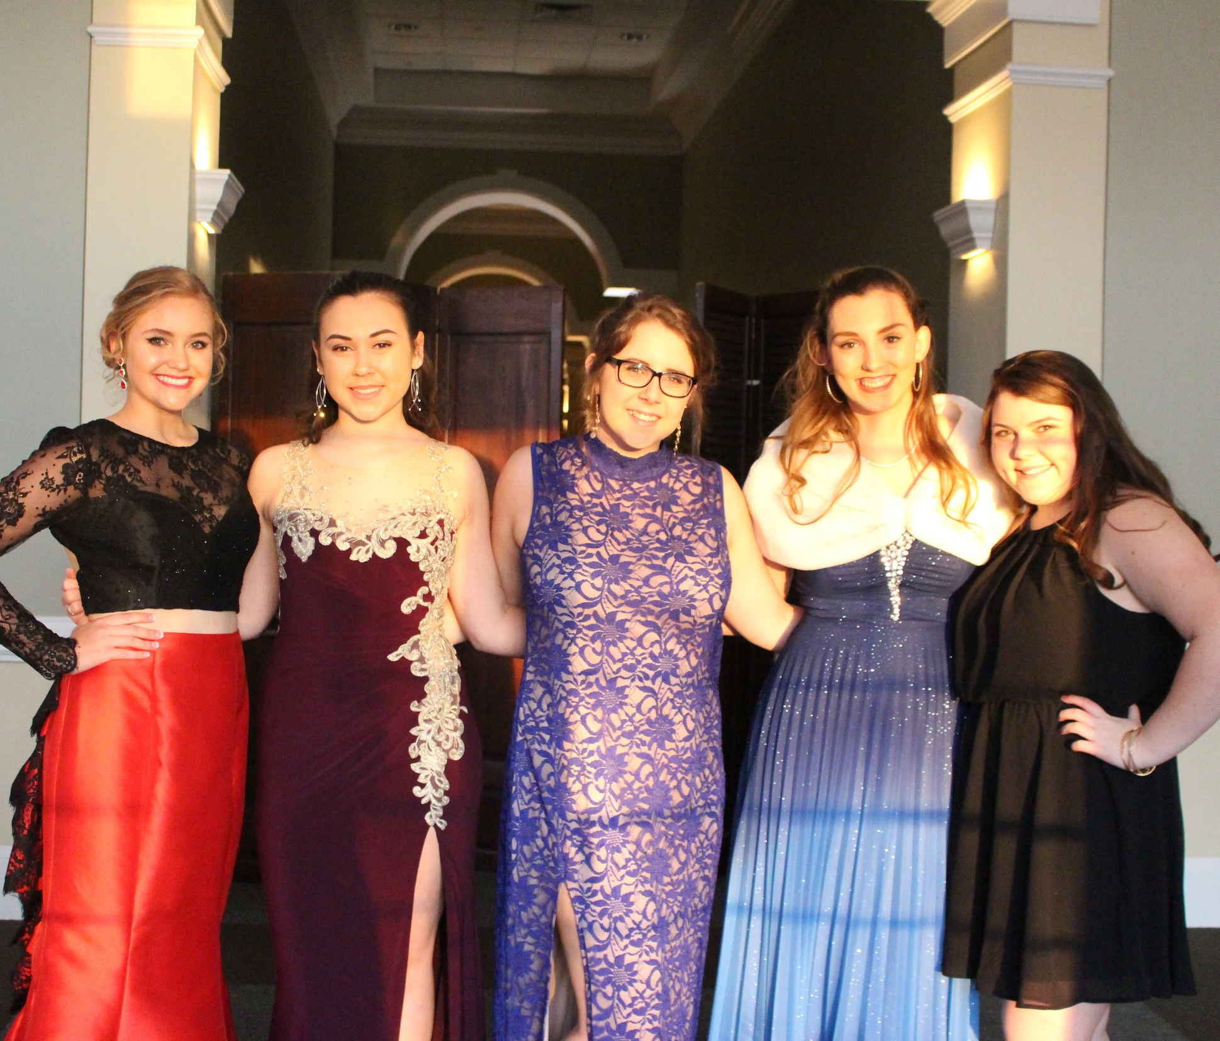
Uniforms

Slide 6
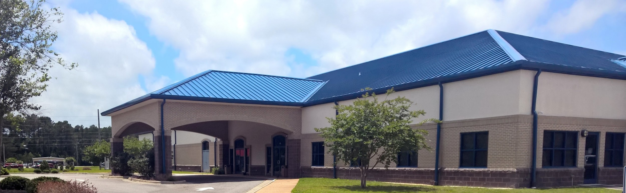
1. LOCATION/DATE/TIME OF CEREMONY HOURS
LOCATION: Brunswick Senior Center at Supply
101 Stone Chimney Rd SE, Supply, NC 28462
DATE: 09 MARCH 2024 (TIME: ARRIVAL-5:30PM & RECIEVING LINE-6:00 PM & DINNER/ DANCE-7:00 to 11:00PM)

Slide 7
MILITARY BALL ETIQUETTE

Slide 8
2. Expectations – CONDUCT INSIDE
NO
YES

Slide 9
2. Expectations – CONDUCT OUTSIDE
NO
YES

Slide 10
2. Expectations - EATING
NO
YES

Slide 11
2. Expectations - DANCING
YES

Slide 12
3. CONCLUSION
Mandatory event
Good Behavior is expected- fun had by all
Cost- $30 (Collected every Monday and Wednesday)
Tickets (6 Tickets at $5 each)
Raffle ( 08 March) $100 Cash
Checks made out to WBHS JROTC
Music Playlist forthcoming.

